Slide 1
Surveying 1 million diverse Wildchat conversations: In the Wild use cases of ChatGPT
By Jason Leung and Sharan Giri

Slide 2
About us
Jason Leung and Sharan Giri – both 1st year Master's of Data Science students interested in ChatGPT and Natural Language Processing (NLP) but with little to no experience in Big Data and especially implementing Machine Learning and NLP

Slide 3
What is the Wildchat Dataset?
 | Full Toxic Dataset | Non-toxic | Non-toxic + English Only
Total Turns of Conversations | 2+ million | 2+ million | 1+ million
Number of Conversations | 1+ million | 800,000+ | 500,000+
File Size (in Gigabytes) | 5 GB | 3.3 GB | 2+ GB
OpenAI Moderation | Hate/violence/ sexual/self-harm/ obscene | (PI) Personal Identifying Info
Core Data Fields | Location, Conversation, Toxic, | Redacted (of PI), Primary Language
Secondary Data Fields | 2023-2024 timestamp, Hashed_IP | Turns in conversation

Slide 4
Problem
The challenge of Big Data: How do we code and process Wildchat?
What is the most interesting but realistic and manageable project idea for this dataset and our two month timeline?
Scale Down from 1 Million: Focus on 2 types of conversation categories:
Journalism / Plagiarism
Programming / Coding
Utilize PySpark's parallel processing and pre-process as much as possible especially NLP, to have a smooth and demo friendly UI
Can't do everything: Jailbreaking is intriguing but too complicated. Most NLP will take longer than 2 months

Slide 5

Journalism – From Embellishing articles to Plagiarism
-Reproducing some of the findings of paper "Case Studies of Generative AI's use in Journalism"
-Journalists use ChatGPT to find catchy headlines but also to auto-complete articles or even plagiarize articles from another news outlet

Slide 6

Case study: mediterranean newspaper taking things too far?
Important not to reveal info that could lead to the singular identification of the newspaper or worker
Leave it at a smaller Mediterranean country, (probably) one person working at a news outlet used ChatGPT 20+ times over course of the year
For creating a catchy headline
Producing news articles from company press release
Creating articles from scratch using source material
Plagiarize articles from another news outlets and rephrasing to avoid detection

Slide 7

Programming / Coding Category
- Python, HTML, SQL, basically any programming language is found for ChatGPT
-Ask to fix syntax, complete code etc.

Slide 8
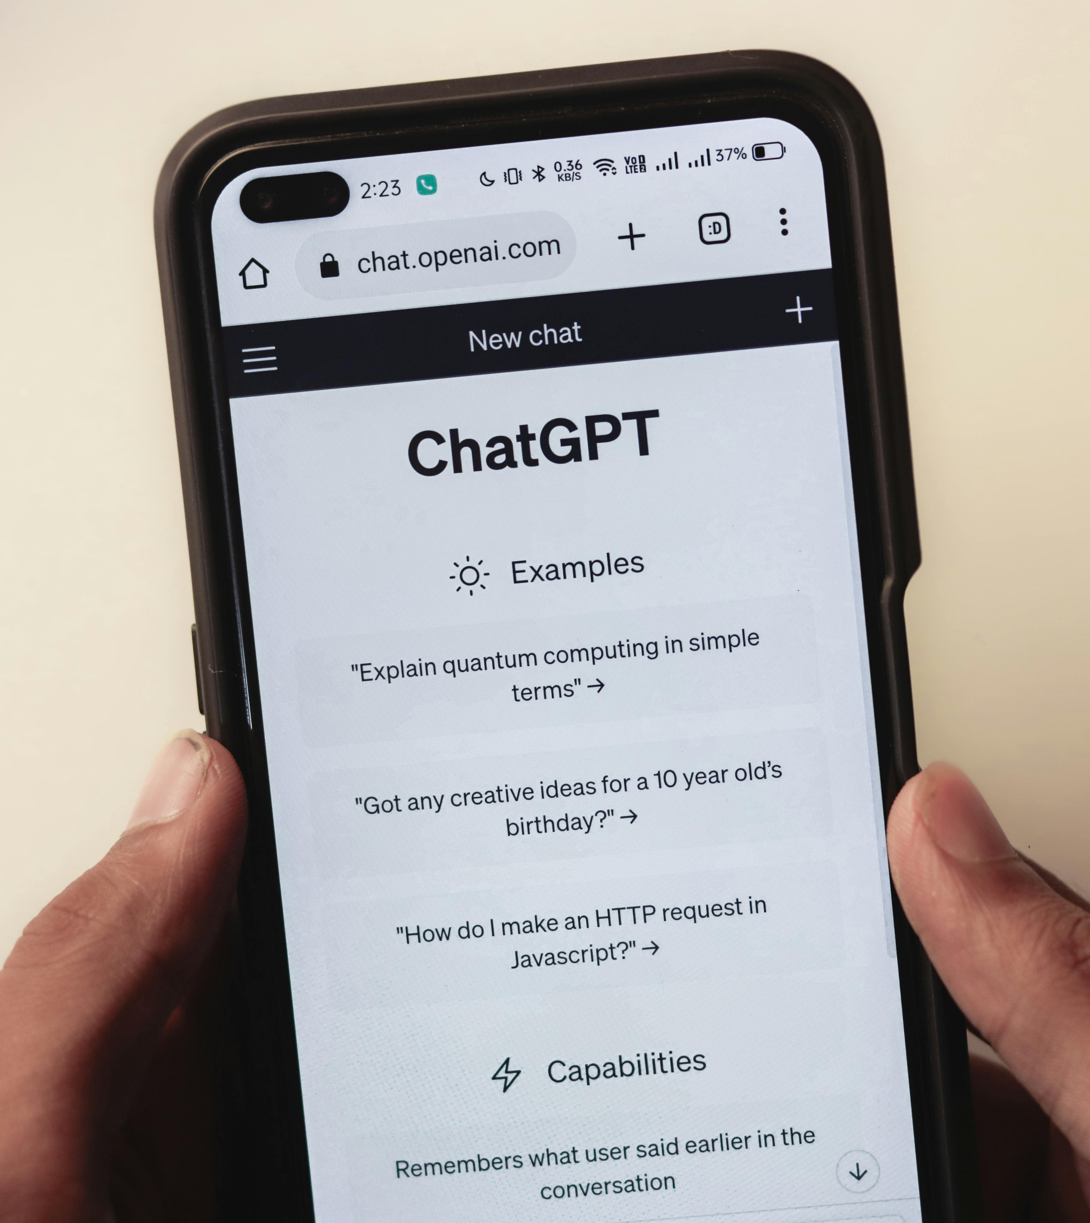
DEMO: Our Flask UI and Keyword Search
Search criteria includes:
Model version (ChatGPT 3.5 or 4.0)
Country and State if have IP address location
Minimum and maximum number of turns in the conversation
Will only return non-toxic conversations with no personal identifying info
Simple keyword search based on term frequency
Try it out – time allowing – we want 2-3 volunteers!
Diagram on UI and pipeline

Slide 9

Thank you
Question and Answer session:
Feel free to ask anything or email:
leung.jaso@northeastern.edu
giri.sha@northeastern.edu
https://github.com/sharan0276/WILDCHAT

